Slide 1
Software Construction & Development
Week 07
Abeeha Sattar

Slide 2
Collections

Slide 3
The Collections Framework
The Collections Framework is a sophisticated hierarchy of interfaces and classes that provide state-of-the-art technology for managing groups of objects.
The Collections Framework was designed to be high performance. The implementations for the fundamental collections (dynamic arrays, linked lists, trees, and hash tables) are highly efficient.

Slide 4
The Collections Framework
The entire Collections Framework is built upon a set of standard interfaces.
Algorithms are another important part of the collection mechanism.
Algorithms operate on collections and are defined as static methods within the Collections class.

Slide 5
The Collections Framework
Iterator interface is closely associated with the Collections Framework.
An iterator offers a general-purpose, standardized way of accessing the elements within a collection, one at a time.
An iterator provides a means of enumerating the contents of a collection
Spliterators are iterators that provide support for parallel iteration

Slide 6
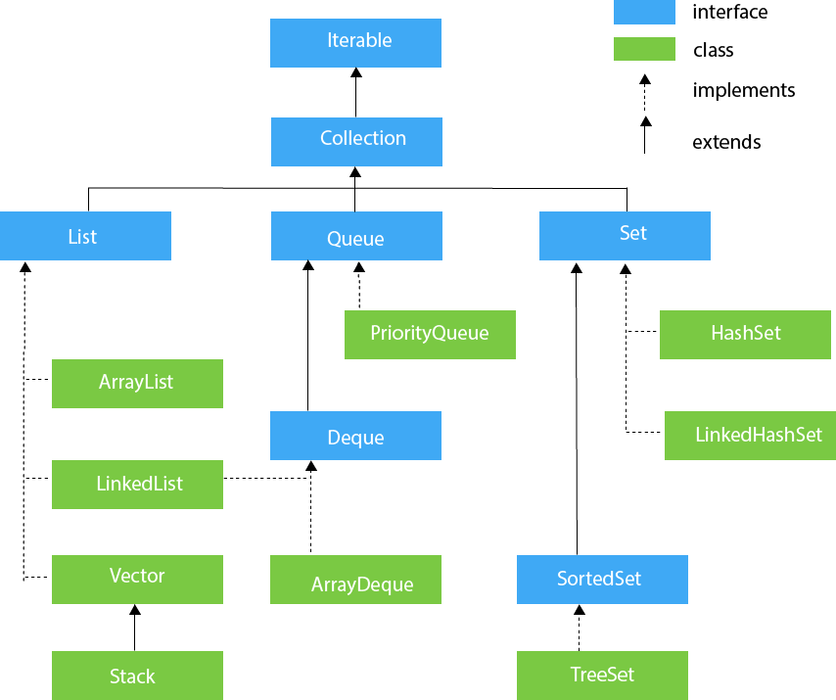

Slide 7
The Collection Interface
The Collection interface is the foundation upon which the Collections Framework is built because it must be implemented by any class that defines a collection. Collection is a generic interface that has this declaration:
interface Collection<E>
Here, E specifies the type of objects that the Collection will hold.

Slide 8
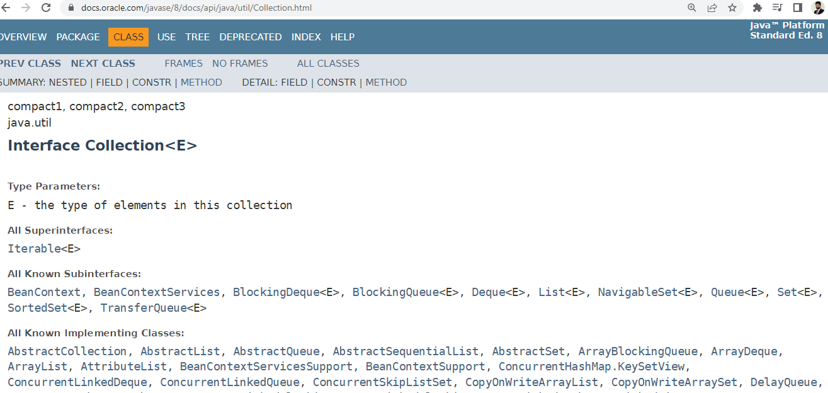

Slide 9
The List Interface
The List interface extends Collection and declares the behavior of a collection that stores a sequence of elements. Elements can be inserted or accessed by their position in the list, using a zero-based index. A list may contain duplicate elements. List is a generic interface that has this declaration:
interface List <E>

Slide 10
The Set Interface
The Set interface defines a set. It extends Collection and specifies the behavior of a collection that does not allow duplicate elements. Therefore, the add( ) method returns false if an attempt is made to add duplicate elements to a set. With two exceptions, it does not specify any additional methods of its own. Set is a generic interface that has this declaration:
interface Set <E>

Slide 11
The SortedSet Interface
The SortedSet interface extends Set and declares the behavior of a set sorted in ascending order. SortedSet is a generic interface that has this declaration:
interface SortedSet <E>

Slide 12
The Queue Interface
The Queue interface extends Collection and declares the behavior of a queue, which is often a first-in, first-out list. However, there are types of queues in which the ordering is based upon other criteria. Queue is a generic interface that has this declaration:
interface Queue <E>

Slide 13
The Deque Interface
The Deque interface extends Queue and declares the behavior of a double-ended queue. Double-ended queues can function as standard, first-in, first-out queues or as last-in, first-out stacks. Deque is a generic interface that has this declaration:
interface Deque <E>

Slide 14
Self Study
Table 19-1, 19-2, 19-3, 19-5, 19-6 from Book (Java the complete reference)

Slide 15
The Collection Classes
Collection Classes implement Collection Interfaces
Some of the classes provide full implementations that can be used as-is.
Others are abstract, providing skeletal implementations that are used as starting points for creating concrete collections.

Slide 16
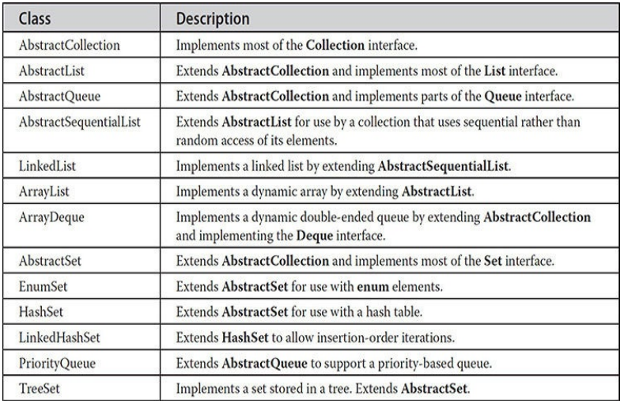

Slide 17
Collection Classes (that we will discuss)
ArrayList
LinkedList
HashSet

Slide 18
Iterator/ListIterator
Iterator enables you to cycle through a collection, obtaining or removing elements.
ListIterator extends Iterator to allow bidirectional traversal of a list, and the modification of elements.
Both are generic interfaces:
interface Iterator <E>
interface ListIterator <E>

Slide 19
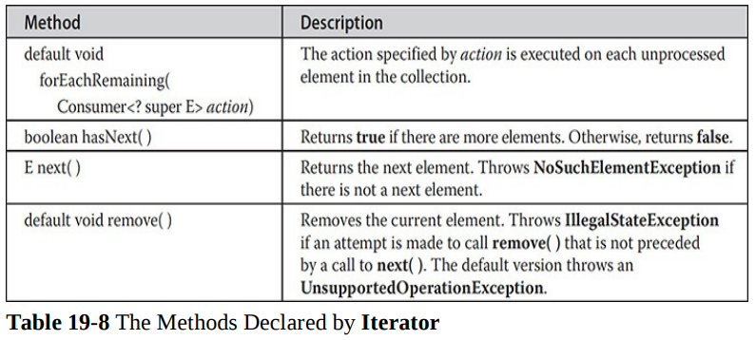
Iterator Methods

Slide 20
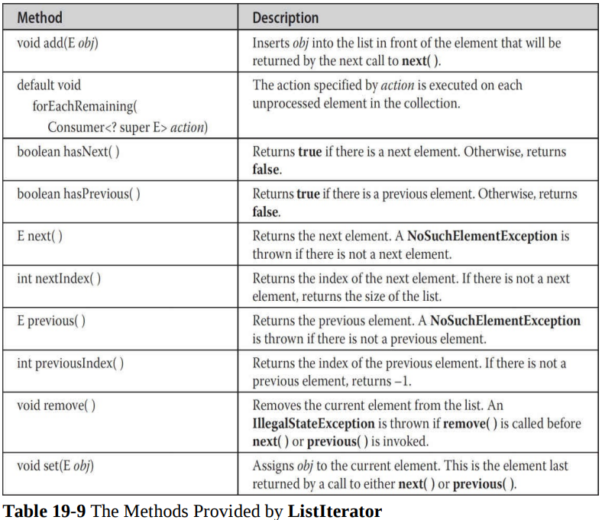
ListIterator Methods

Slide 21
Using an Iterator
To use an iterator to cycle through the contents of a collection, follow these steps:
1. Obtain an iterator to the start of the collection by calling the collection’s iterator( ) method.
2. Set up a loop that makes a call to hasNext( ). Have the loop iterate as long as hasNext( ) returns true.
3. Within the loop, obtain each element by calling next( ).

Slide 22
Using a ListIterator
For collections that implement List, you can obtain an iterator by calling listIterator( ).
NOTE: ListIterator is available only to those collections that implement the List interface.

Slide 23
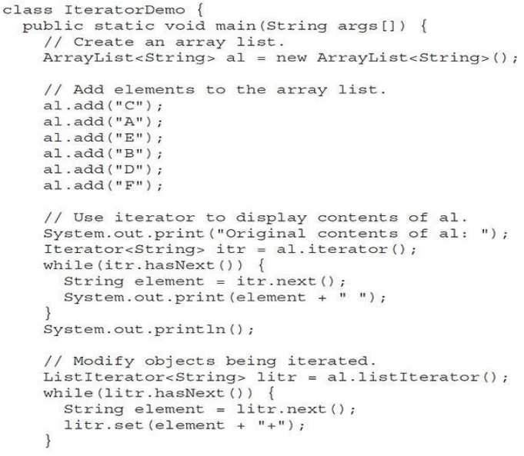

Slide 24
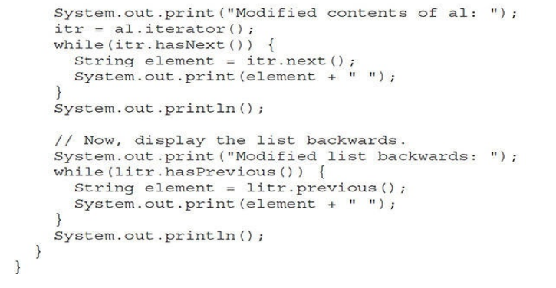

Output:

Slide 25
Using For-Each
for can cycle through any collection of objects that implement the Iterable interface
Useful if:
You won’t be modifying the contents of a collection
You won’t be obtaining elements in reverse order

Slide 26
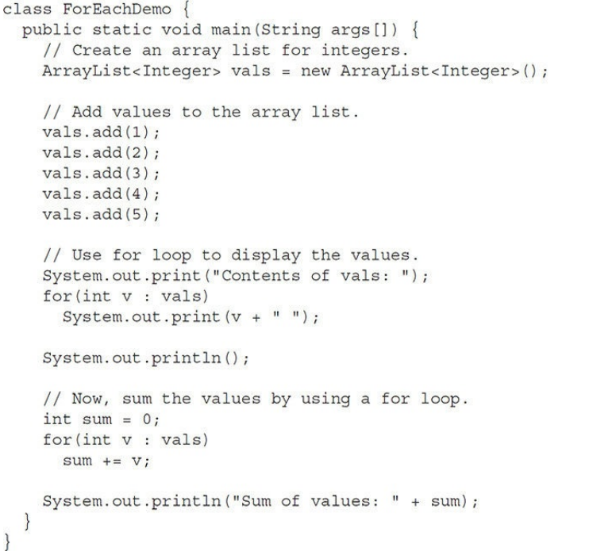

Output:

Slide 27
Fin.

